Slide 1

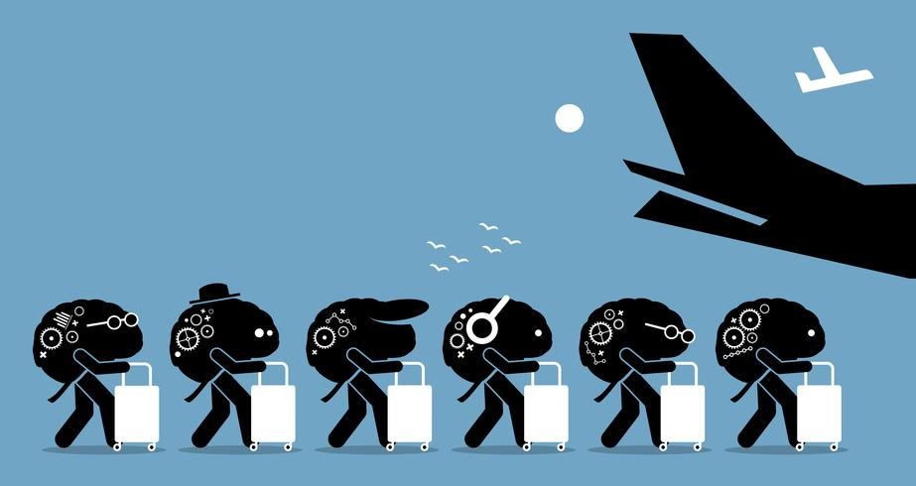
Measures to prevent “Brain Drain”
By Parth Reddy, IX/9 A

Slide 2
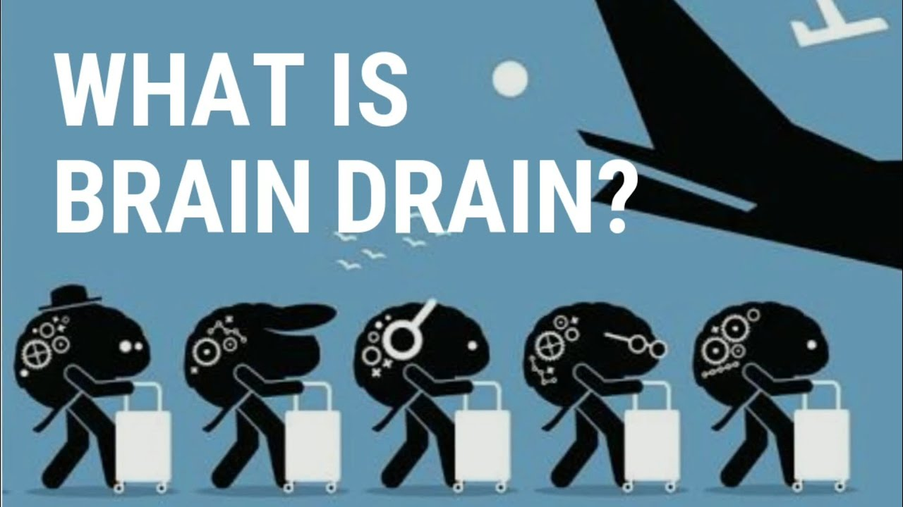
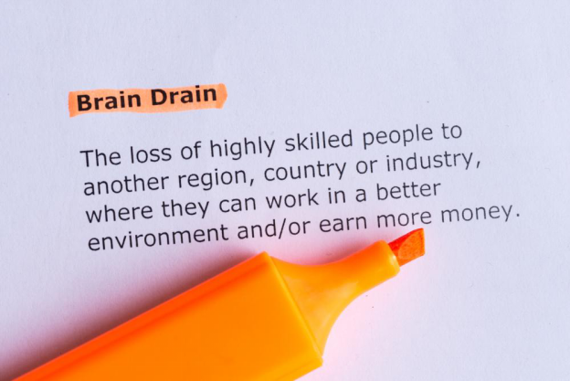
What is Brain Drain?
Brain Drain means The emigration of highly trained or qualified people from a particular country. It can result from political turmoil or the existence of more favourable professional opportunities elsewhere.
Its effects are:
Loss of meagre professionals in countries which are financially weak. Poor African countries like Ethiopia become even Moorer due to Brain Drain.
Brain drain threatens the economic prospects and competitiveness of an affected country. A diminished labour force and migration of high-income taxpayers often result in missed opportunities, reduced growth, lower employment and reduced overall tax revenue.
Creates more Inequality in the world as advanced economies receive further benefits and the backward economies continue to be at the receiving end.
Brain drain is a loss to countries of origin because it deprives these countries of the innovations of their professionals. Such countries have become culturally and technologically dependent on the West.

Slide 3
How to prevent it?
Increasing investments into certain areas of the economy
Offering competitive wages
Paving the way for legal and social reform
Improving the quality of resources, such as housing and healthcare
Providing affordable housing solutions
Honest governance at the national and international levels is the need of the hour. Special attention is needed towards the maintenance of reasonable security for people’s lives and property which is essential for economic progress.
Higher wages for the Native according to their qualifications is essential, instead of overestimating and hiring expatriates, which are more costly.
The quality of Education should be improved. Quality Education plays a powerful role, especially in the growing problems of international migration. Expanding a better educational infrastructure will prevent emigrants from seeking higher education abroad.
Since Native Countries are also the stakeholders of the Brain Drain, an agreement can be made between rich and poor countries that prohibit the rich from taking intellectuals of the poorer states.

Slide 4

Thank you for reading my Presentation!

